Slide 1
Cimarex TU 2020 Capstone Project
Rita Behm & Kailey Schrum

Slide 2
Overview
Your geologist has found a new unconventional play in the Permian Basin. He is absolutely certain it is analogous to the lower Wolfcamp (C&D) in Culberson County, but you will be the first to drill in this township.
Your landman obtained acreage in this sleepy township for $1000/acre for all 36 sections and has provided you an obligation schedule you must satisfy over the next 5 years to hold all the leases. You are a 60% WI owner in every section and have a 75% 8/8ths NRI. Any 2 mile created unit/section creates 1 new obligation.
As asset engineering team you must propose a 5 year drill plan that satisfies all obligations, sets aside enough capital and time to determine a reasonable spacing, and you must propose whether or not to use some of your drilling capital to own and operate gas midstream or if you recommend bringing in a 3rd party to operate gas midstream for a fixed fee.
Oil will be trucked at $2.00 per bbl escalating at 3% per year up to 10 years and water has a 3rd party agreement signed at .50 cents per bbl that escalates year over year at CPI for up to 10 years. Base fixed LOE excluding water is $6000/month per well.

Slide 3
Data Supplied
Reservoir/Field Planning
Obligation map of area
Total budget for 5 years to be used to drill wells or build midstream system
It takes 30 days to drill a 1 mile well, it take 45 days to drill a 2 mile well. It takes 7 days to frac a one mile well, it take 14 days to frac a 2 mile well. (You have no rig/completion crew constraints)
You have a 40% non op partner
Capital Costs for drilling wells, and general gas midstream capital costs (pipe and compression)
Any wells online prior to 12/31/2014 in Culberson County can be used in building your typecurve
General log of zone or log properties to calculate Recovery factor/help ground spacing
Midstream/Marketing
Trunk line pipe flow volumes and compression capacity
Midstream opex per mcf if you operate
3rd party midstream fee proposal
Runtime and fuel assumptions for you or 3rd party midstream company
General processing costs/values
Gas, NGL, and Oil flat price for received pricing

Slide 4
Team Recommendation (What’s the End Goal)
5 year drill recommendation to satisfy leases showing locations/capital per year/schedule
Spacing proposal test/timeline to be able to understand field spacing by year 5
How many wells or tests do you think you will need, where would you put them, what if any information do you need you are not provided that you think would help.
Recommendation on build own midstream system, including capital schedule per year and full cycle return or 3rd party midstream full cycle return
BTAX PV10 of your recommendation including a summary of the inputs and your output roll up.
**Your rationale for each of the above**

Slide 5
The Curveball
Based on your above recommendation due 1 month before final presentation you will have one last piece of unknown information added to the project and you must then choose how you adapt or planned ahead to adapt to this curve ball.
Your decision making process, how thoughtful you were on your development plan and how inquisitive you are on identifying risks/uncertainty to your program will determine this last piece.
Examples of that last piece of information
Maybe your company develops a technology innovation and changes well productivity or cost
Maybe the 3rd party that gathers your gas has performance issues or is bought out

Slide 6
Contacts
Rita Behm: rbehm@cimarex.com
Cell: 832-620-2640
Kailey Schrum: kschrum@cimarex.com
Cell: 918-605-4187
We will respond to reasonable questions within 24-48 hours of being asked.

Slide 7
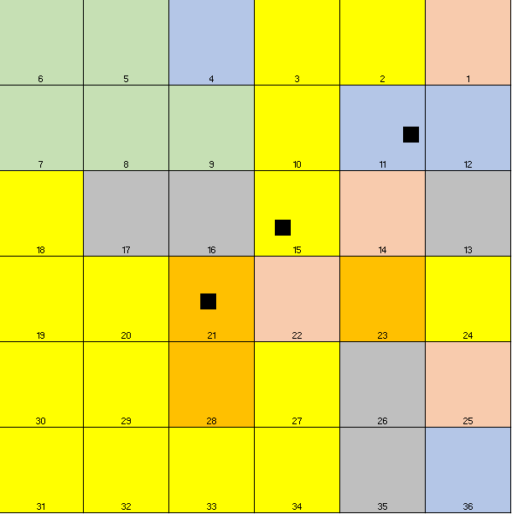
Example Section
Drilled 2 1 miles wells in section 1.
Wells expect to make 4,000 MCFD each
Gross drill capital $11,600,000
Compression Capital= 125,000*8=$1,000,000
GL 1.2 miles *80,000*4=$384,000
HP .28 miles *160,000*16=$716,800 (320MM/D)
LP 1.2 miles *80,000*12=$1,152,000 (60MM/D)
Plant Meter Connect=$1,000,000 (one time cost)
Gross Capital Total: $15,852,800
Net Capital Total: $9,511,680
Timing:
Drilling 1/1-3/1
Frac 3/2-3/16
First prod 3/17
LP12”
GL 4”
HP 16”

